Slide 1


Swag Labs — QA Testing Documentation
This presentation provides a comprehensive overview of our QA testing engagement for the Swag Labs e-commerce application. It covers our dedicated team, testing scope, strategic approach, and the key results achieved. Our goal is to ensure a robust and reliable user experience for all Swag Labs customers.

Slide 2






Team & Responsibilities: Our Dedicated QA Professionals
Our testing effort was a collaborative endeavor, with each team member focusing on critical areas of the Swag Labs application to ensure comprehensive coverage and quality.
Ahmed Meatmed
Malak Hamouda
Team Leader - SideBar
Cart Page
Lead test strategy and functional testing for the Items Page. Coordinated team tasks and comprehensive reporting.
Validated cart functions, identified edge cases, and meticulously logged defects with detailed steps and screenshots.
Mariam Awad
Shimaa Emad
Home Page
Login Page
Tested home page components, content accuracy, and the overall usability flows for an optimal user experience.
Verified login processes, session handling, and error states across various credential scenarios.
Saif Sharaf Eldin
Ziyad Lotfy
Items Page
Checkout
Focused on ensuring the reliability and functionality of product displays and item interactions.
Tested the entire checkout sequence, payment validation, order confirmation, and robust error handling.

Slide 3
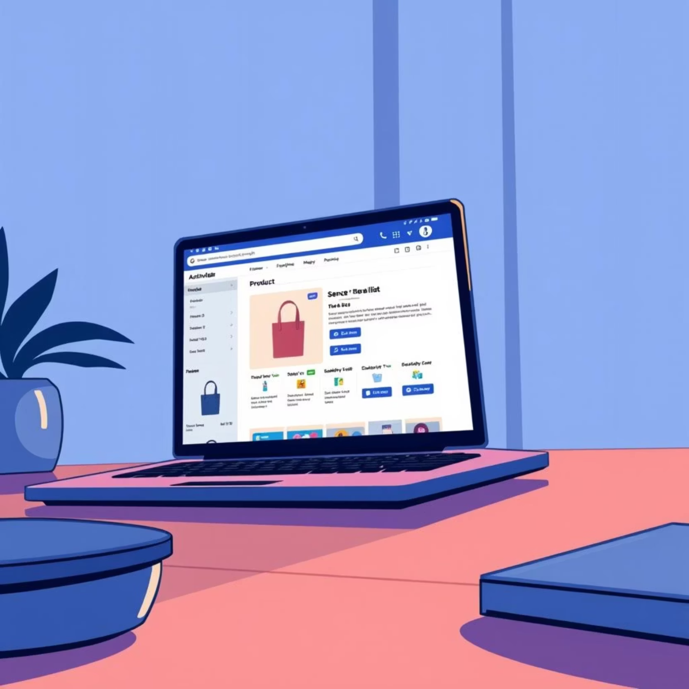
Project Introduction: Ensuring a Seamless Shopping Experience
Purpose
The primary purpose of this testing engagement was to confirm that Swag Labs performs reliably, meets critical user needs, and delivers a consistently smooth and error-free shopping experience for all users.
Scope
Comprehensive functional testing across key user journeys (login, cart, checkout, navigation)
Strategic exploratory testing sessions to uncover unforeseen issues and usability quirks
Automation of high-value regression test cases to maintain stability with continuous development

Slide 4
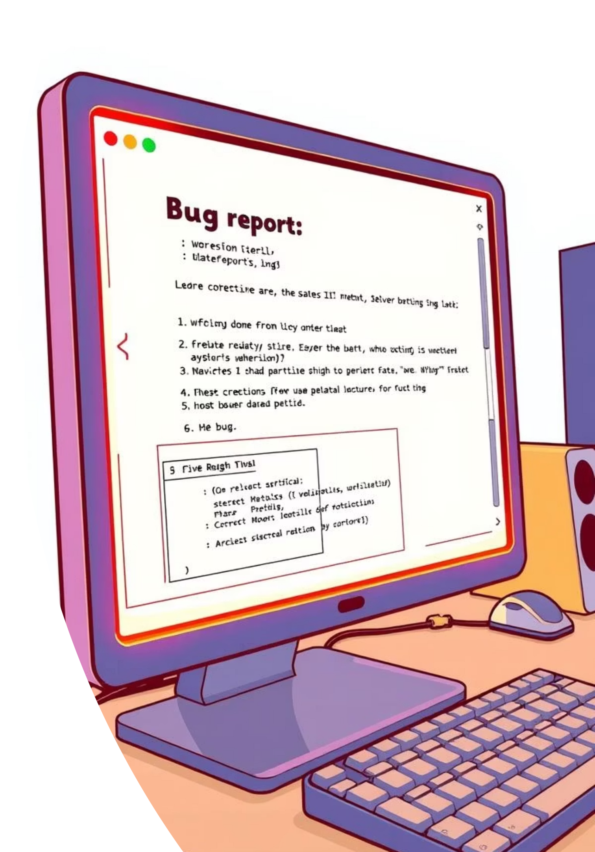
Problem & Project Goal: Elevating Swag Labs Quality
Problem Identified
During initial testing phases, we identified multiple defects across various severity levels (critical, high, medium). These defects were found to significantly affect core purchase flows and overall system usability, potentially leading to a degraded user experience.
Project Goal
Our central objective was to dramatically improve the overall quality of the Swag Labs application. This included detecting and resolving defects early in the development cycle, ensuring reliable functionality, and ultimately enhancing user satisfaction through a robust and stable platform.

Slide 5

Implementation & Feasibility: Our Testing Approach
Our testing strategy combined both manual and automated methods to achieve broad coverage and efficient defect detection.
Leveraged session-based exploratory testing for broad, adaptive coverage across new features and complex user interactions.
Developed structured and detailed test cases for critical user journeys, such as login, product selection, and the entire checkout process, ensuring no key flow was overlooked.
Implemented automated regression testing using Selenium WebDriver with Java to efficiently re-verify existing functionalities after new code deployments, saving valuable manual testing time.

Slide 6





Challenges & Mitigations: Overcoming Obstacles
Our QA process faced several common challenges, but proactive strategies were put in place to ensure smooth progress and successful outcomes.
Unclear Coverage
Limited Time
Adopted session-based test management and charters to clearly define, track, and measure testing coverage, identifying and addressing any gaps systematically.
Prioritized and automated critical regression test cases and focused exploratory sessions on high-risk areas to maximize impact within time constraints.
Communication Gaps
Environment Instability
Introduced clear, standardized bug report templates, held regular team syncs, and utilized centralized issue dashboards to enhance communication and transparency.
Maintained reliable backups, stable test data sets, and conducted mandatory smoke checks before each testing session to ensure a consistent test environment.

Slide 7








Key Features & Deliverables: Our Comprehensive Outputs
Our testing efforts generated a suite of essential documentation and automated assets, crucial for ensuring the quality and maintainability of Swag Labs.
Test Plan
Test Cases
A detailed document outlining objectives, scope, risk assessment, and the overall test strategy for both manual and automated testing activities.
Specific, validated test cases covering login, search, cart interactions, checkout, and navigation flows, each with defined expected results.
Bug Reports
Automation
Comprehensive reports detailing reproducible steps, clear screenshots, assigned severity levels, and suggested mitigation paths for each identified defect.
Robust Selenium WebDriver + Java-based automation scripts, developed using the Page Object Model (POM) for scalable and maintainable regression suites.

Slide 8





Key Testing Strategies for Swag Labs
Effective software quality assurance relies on a combination of strategic testing approaches. Here are some fundamental methods we employed for the Swag Labs application:
Whitebox Testing
Blackbox Testing
Boundary Value Analysis (BVA)
Examines internal system structure, code, and infrastructure for vulnerabilities and errors. Application: Unit testing, security analysis, code coverage.
Validates functionality and user experience without knowledge of internal design or implementation. Application: User acceptance testing (UAT), system testing, integration testing.
Tests values at, just below, and just above the boundaries of input ranges to find edge case defects. Application: Input fields, age restrictions, financial limits.
2-Value Analysis (2VA)
Equivalence Partitioning (EP)
Focuses on two extreme valid values within an equivalence partition, such as minimum and maximum. Application: Boolean inputs (true/false), simple on/off states.
Divides input data into partitions where all values are expected to behave similarly, reducing redundant tests. Application: Form validation, pricing tiers, user roles.

Slide 9
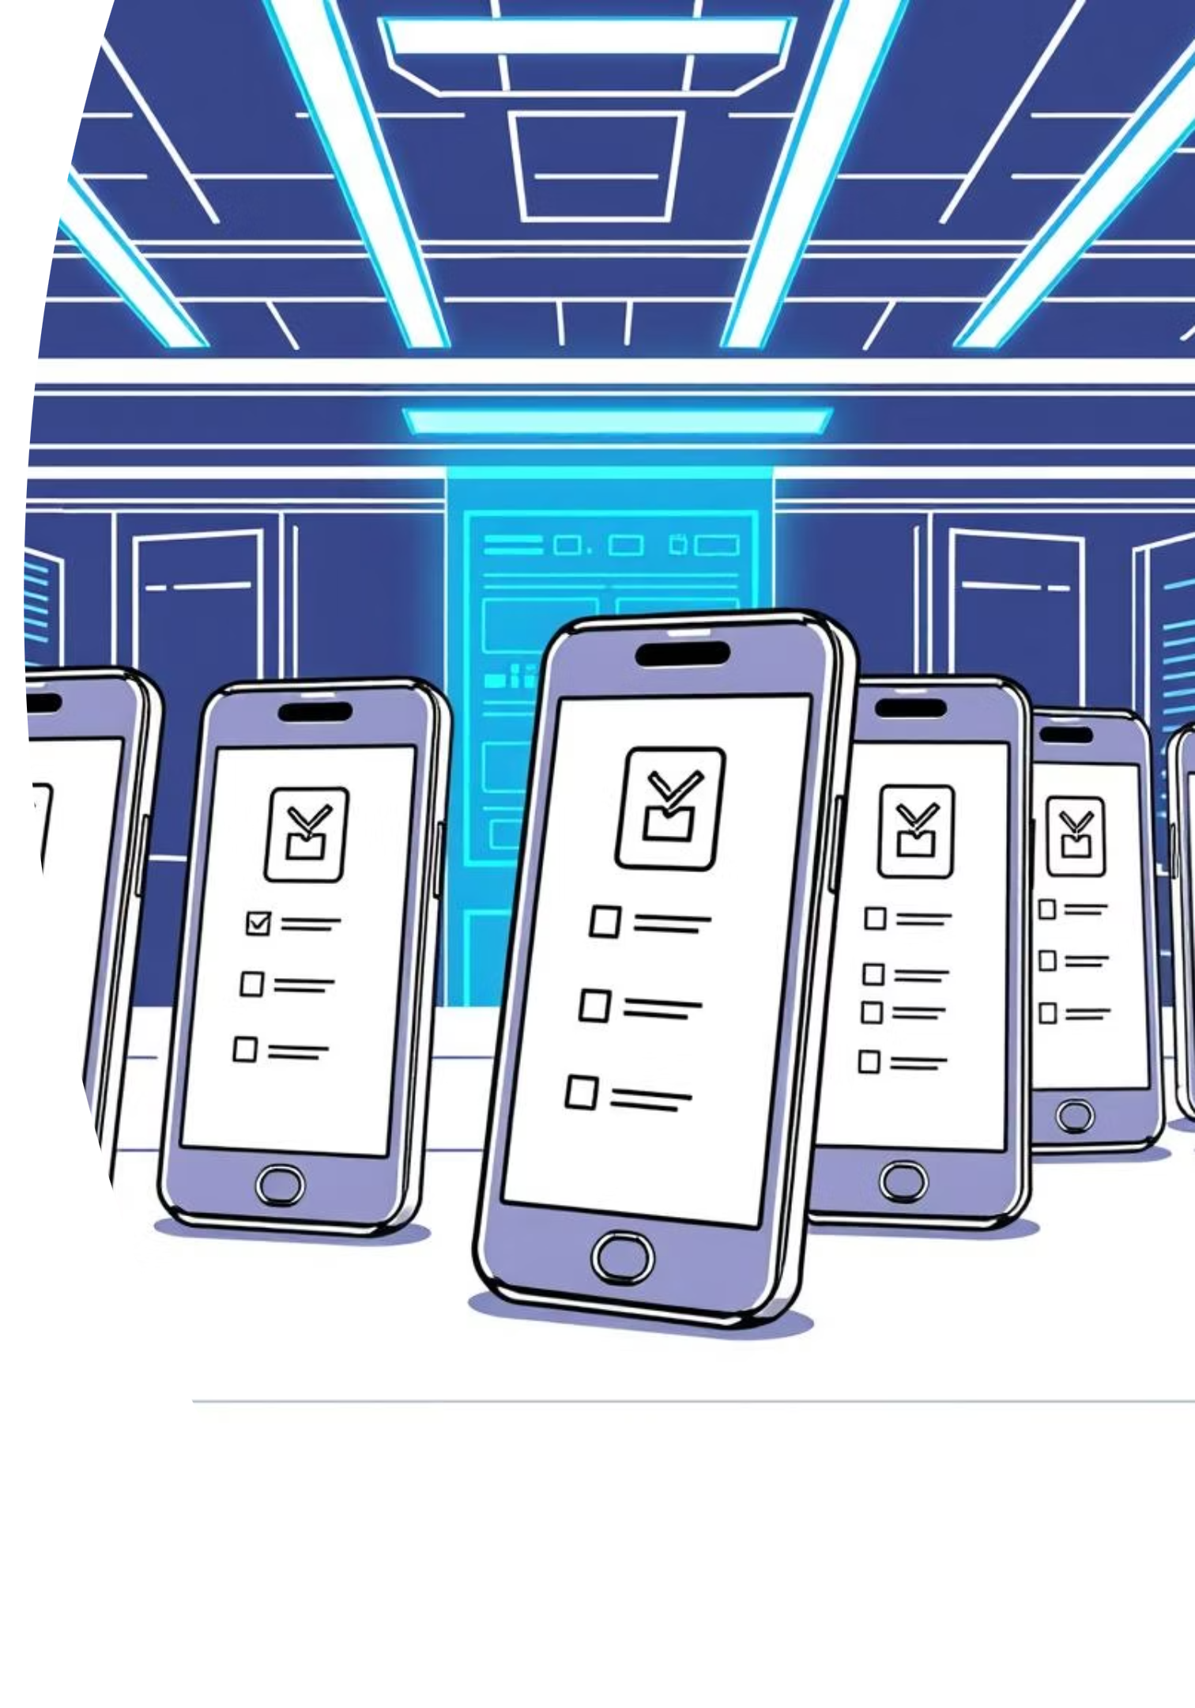
Mobile Testing Results
Our QA team extended testing coverage to mobile platforms, conducting comprehensive testing on Android devices to ensure cross-platform compatibility and optimal user experience.
Testing Overview
Key Bug Categories Found
68 test cases executed across mobile platform between functional and non functional
High Severity Issues: Cart functionality problems, checkout validation bypasses, pricing calculation errors
26 bugs identified with detailed documentation
Medium Severity Issues: Reset app state not working properly, user lockout scenarios
Devices tested: Xiaomi Redmi Note 13 4G, Realme C61, Oppo F9
Low Severity Issues: Social media links non-functional
Operating Systems: Android 10, Android 14, Android 15
Critical Findings
"Problem_User" account shows multiple cart and product interaction failures
Checkout process accepts whitespace-only input in required fields
Product removal from cart doesn't update pricing correctly
Social media icons (Facebook, Twitter, Google) are non-clickable across user types
All bugs have been documented with detailed steps, screenshots, and video evidence for development team review.

Slide 10

Technical Overview: Our QA Infrastructure
Stack & Tools
Language: Java, chosen for its robustness and widespread use in enterprise-level automation.
Automation Framework: Selenium WebDriver, providing powerful browser automation capabilities.
Design Pattern: Page Object Model (POM), ensuring maintainability, reusability, and readability of our test code.
Browsers Covered: Comprehensive testing across Chrome, Firefox, and Edge (desktop versions) to ensure cross-browser compatibility.
Reporting: Custom summary reports generated for stakeholders, complemented by detailed execution logs for technical teams.
All tests were executed in stable desktop environments. Mobile testing is recognized as crucial future work and is part of our strategic roadmap.

Slide 11
Thank You — Questions?
Contact & Next Steps
We are ready to deep-dive into any section of this report or review specific test artifacts based on your needs. Please feel free to schedule a walkthrough of automation scripts, detailed bug triage results, or session recordings.
Resources
Comprehensive test summary reports and execution logs are available upon request.
Direct links to our bug tracker, along with an exported, prioritized backlog categorized by severity.
Access to our automation repository, featuring the Page Object Model (POM) structure and clear run instructions.

